Slide 1
MUSICAL JUKEBOX
Submitted by – MOHD. ZAID
Under the guidance of – mr. vaibhav diwan sir

Slide 2
Introduction
Musical Jukebox is a application to play songs. user can also search the song and make this playlist according to their interest which is being displayed in this application.

Slide 3
Functionalities
1. Play songs
2. Display songs
3. Make playlist
4. search song by name , genre, artist name
5. play pause jump to next song loop etc

Slide 4
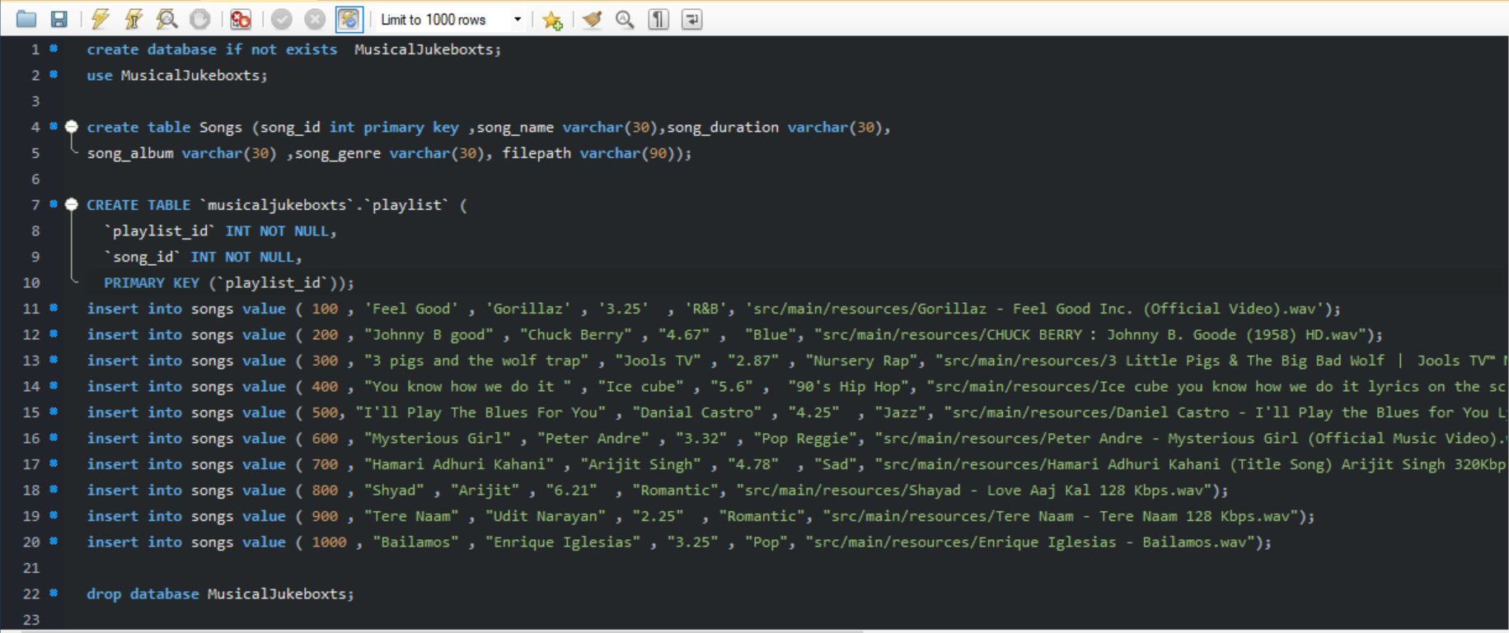
mySql queries

Slide 5
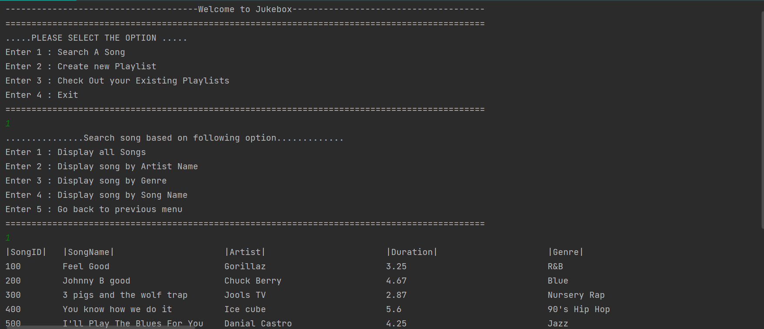
Output screen

Slide 6
Thank you!

